Slide 1
Molecular Biology Biol 480
Lecture 3 January 14, 2019

Slide 2
Announcements/Assignments
Look for lab documents for this week’s lab on the website. Be sure to have your lab journal with you and ready to use. Read and be ready for pre-lab questions.
Lab 1—Bacterial transformation---DNA is the genetic material/gene expression regulation

Slide 3
Where were we…
In terms of cellular macromolecules, why is DNA less “versatile” than protein? Why should DNA be less versatile than protein?
What is the central dogma of molecular biology? What are its exceptions?
One we did not discuss last time---Prions—the infectious agent causing diseases like scrapie (sheep), mad cow disease, chronic wasting disease (deer, elk, moose) and Creutzfeld-Jacob disease and kuru (humans)

Slide 4
Prions—So Interesting! Please read more
https://pdb101.rcsb.org/motm/101
https://www.cdc.gov/prions/index.html

Slide 5
More…where were we?...
Why was protein predicted to be the genetic material, before definitive experiments were done?
Describe how Griffith’s experiment with bacteria hinted at existence of genetic material?
How did Avery MacCleod, and M^{c}Carty extend and simplify Griffith’s experiment?
How did these 3 scientists show strong/definitive support that DNA was the genetic material?

Slide 6
Hershey and Chase
Took a different, maybe more direct approach. They asked the question, “What chemical is essential when building a new organism?”
They used viruses that infect bacteria—bacteriophages. They asked “ what chemical is used as the recipe for building new bacteriophage?”

Slide 7
Ideal system for testing a protein vs nucleic acid question.
Bacteriophages were known to have roughly 50% protein and 50% DNA with very little else in them.
The life cycle was well known and easy to use in the lab. Phage enter E. coli are produced inside the bacteria. Upon release they will consist of newly made components, but presumably will carry the recipe of the earlier generation.

Slide 8
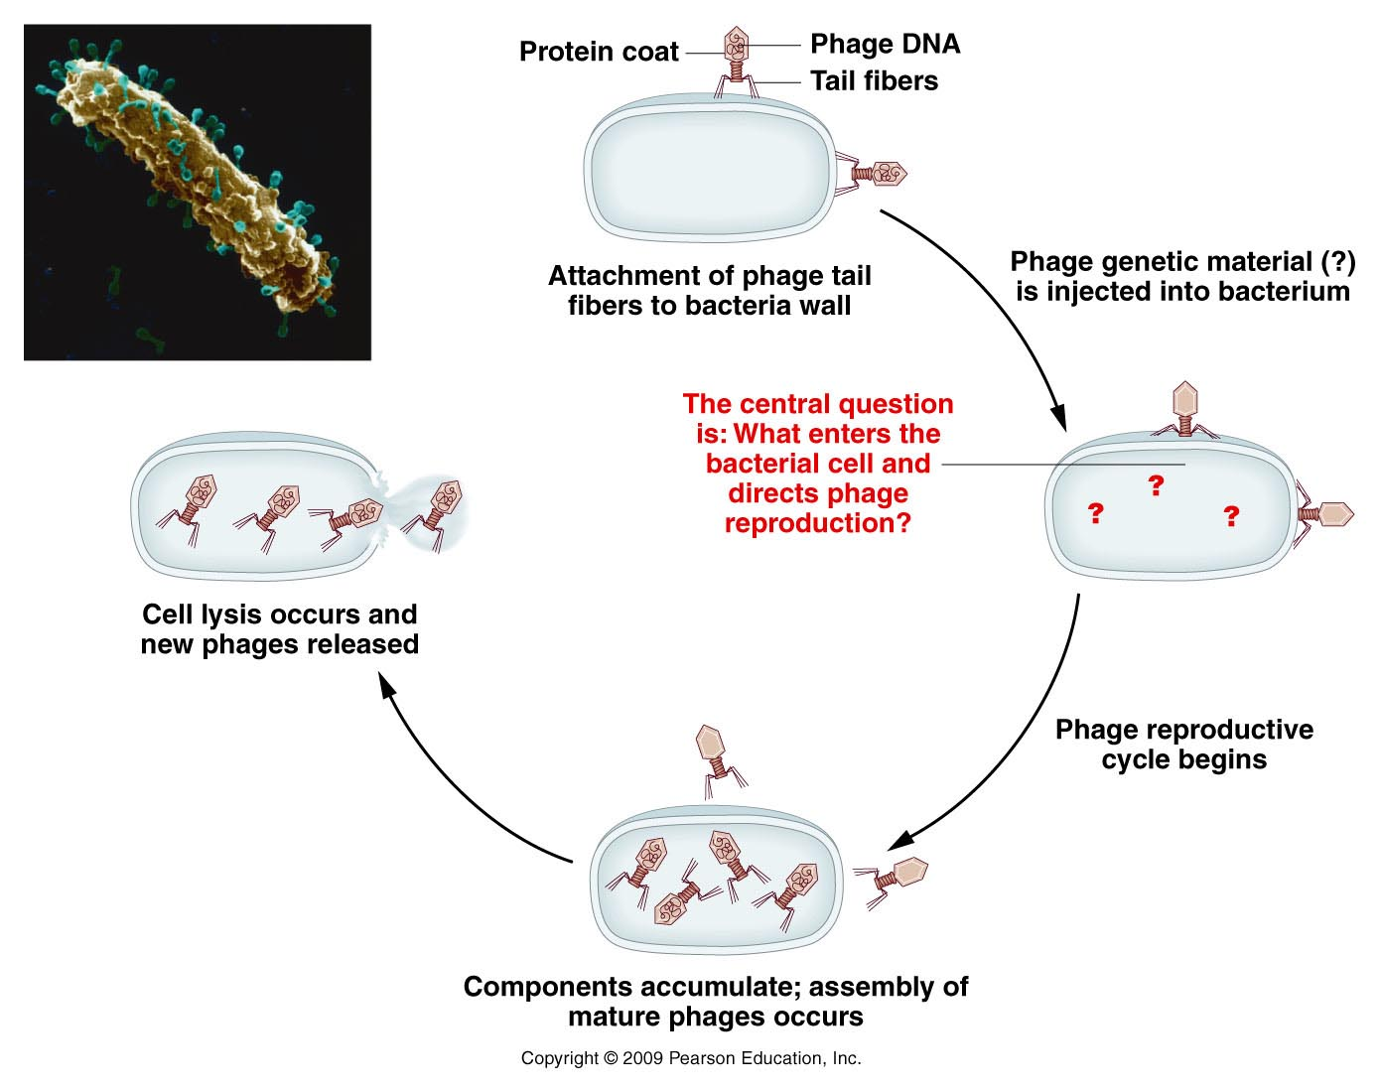
Figure 10.5
Notes:
Figure 10-5 Reproductive cycle of a T-even bacteriophage, as known in 1952. The electron micrograph shows an E. coli cell during infection by numerous phages.

Slide 9
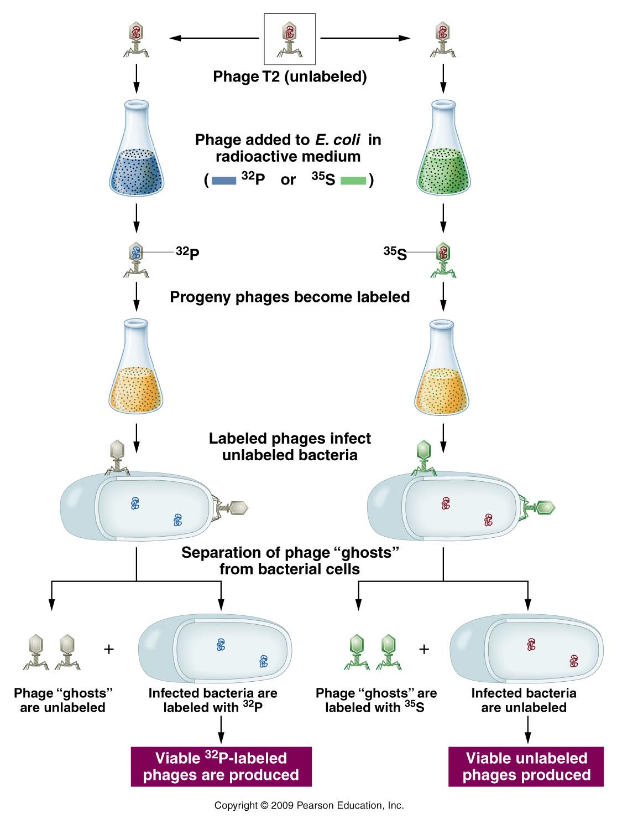
Proteins and DNA could
be uniquely labeled
with radioisotopes.
Labeled phage were
allowed to infect
bacteria.

Slide 10
Conclusion…
Even though the infecting phage incorporated either P-32 or S-35 into phage components, the “offspring” phage only contained P-32.
The molecule of heredity was p-32 labeled DNA, not protein.
The new generation of phage made new proteins (that were not radioactive) as directed by the recipe.

Slide 11
DNA as a molecule
First we have to know the building blocks
Let’s review some nucleic acid biochemistry.
Each nucleotide is the monomer in the larger polymer—nucleic acid.

Slide 12
Nucleotides…
3 components
5-carbon (pentose) sugar
Nitrogenous base
PO₄ group(s)
1 PO₄ group =nucleoside monophosphate
2 PO₄ groups =nucleoside diphosphate
3 PO₄ groups =nucleoside triphosphate
Nucleoside

Slide 13
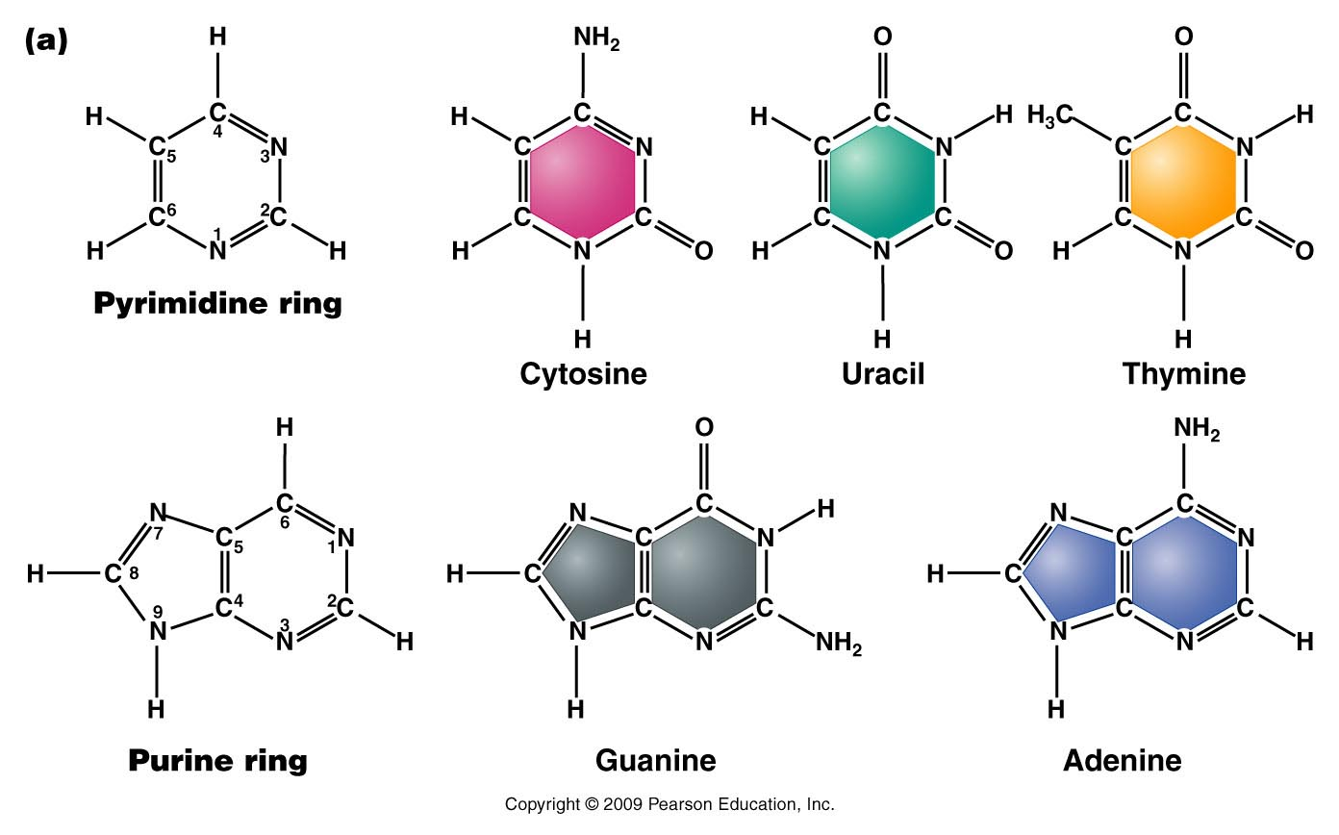
The bases---Do not memorize atomic structure but recognize pyrimidine vs. purine—note numbering of atoms.
Figure 10.9a
Notes:
Figure 10-9a (a) Chemical structures of the pyrimidines and purines that serve as the nitrogenous bases in RNA and DNA. The nomenclature for numbering carbon and nitrogen atoms making up the two bases is shown within the structures that appear on the left. (b) Chemical ring structures of ribose and 2-deoxyribose, which serve as the pentose sugars in RNA and DNA, respectively.Web Tutorial 10.1DNA Structure

Slide 14
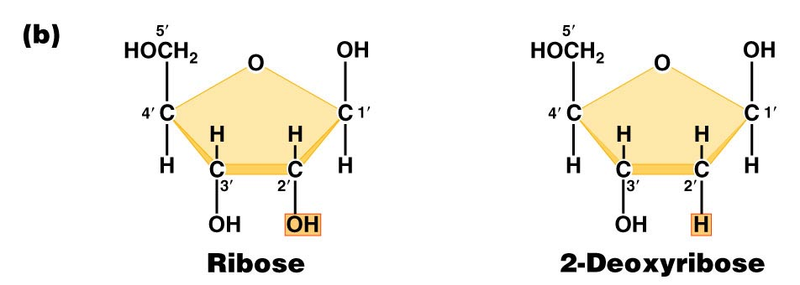
Pentose sugars in RNA and DNA
DRAW THEM!! Note the numbering of atoms (1’, 2’….carbons).
Found in RNA
Found in DNA
Figure 10.9b
Notes:
Figure 10-9b (a) Chemical structures of the pyrimidines and purines that serve as the nitrogenous bases in RNA and DNA. The nomenclature for numbering carbon and nitrogen atoms making up the two bases is shown within the structures that appear on the left. (b) Chemical ring structures of ribose and 2-deoxyribose, which serve as the pentose sugars in RNA and DNA, respectively.Web Tutorial 10.1DNA Structure

Slide 15
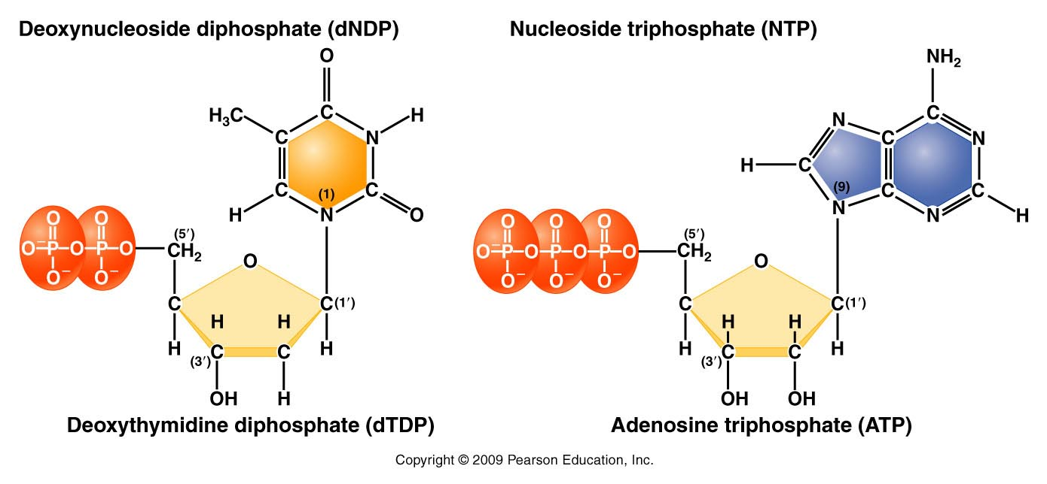
Complete structure of nucleotides
Base forms bond with the 1’ carbon of the sugar
Phosphate forms bond with the 5’carbon of the sugar
d=deoxyribose
no “d”= ribose
Figure 10.11
Notes:
Figure 10-11 Basic structures of nucleoside diphosphates and triphosphates, as illustrated by deoxythymidine diphosphate and deoxyadenosine triphosphate

Slide 16
DNA/RNA made of linked nucleotides
Specific type of linkage joins adjacent nucleotides
5’ carbon of one nucleotide forms a linkage to the 3’ carbon of the adjacent nucleotide
Phosphate links 2 nucleotides in a phophodiester bond

Slide 17
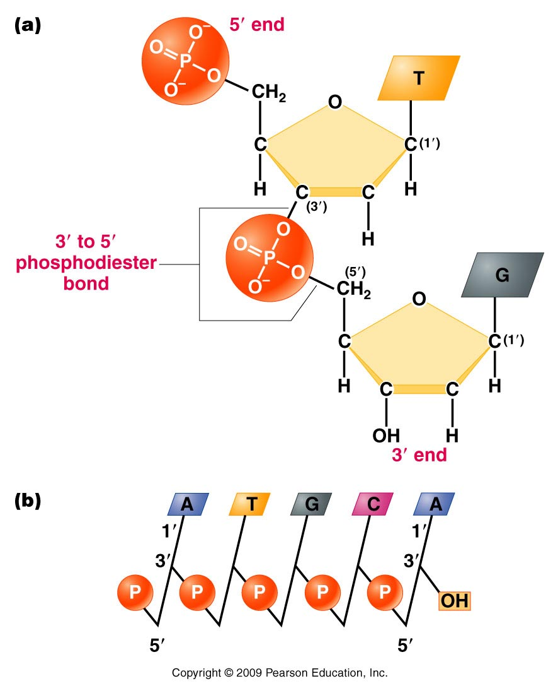
Result is a 5’-3’ linkage and a molecule with 5’ and 3’ ends.
A strand of DNA/RNA
Figure 10.12
Notes:
Figure 10-12 (a) Linkage of two nucleotides by the formation of a C-3’ –C-5’ (3’ –5’) phosphodiester bond, producing a dinucleotide. (b) Shorthand notation for a polynucleotide chain.

Slide 18
The most recently added nucleotide in the strand leaves a free 3’ OH group to continue the building of the strand.
The building blocks are always dNTPs (the previous figure does not make this clear)
The formation of a new ester bond results in the formation of water.

Slide 19
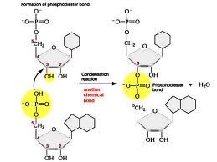
One nucleotide is linked to it’s neighbor in a nucleic acid strand by formation of ester linkages. The phopsphate group on the 5’ carbon of one nucleotide becomes linked to the OH group on the 3’ carbon of another nucleotide.

Slide 20
RNA exists as a single strand* of nucleotides
DNA is a double strand of nucleotides
Strands are connected via non-covalent bonds between specific bases.
Adenine bonds to Thymine
Cytosine bonds to Guanine
* adenine and uracil (and cytosine and guanine) can form bonds in regions of an RNA single strand or in DNA-RNA hybrids.
Complementary base pairing

Slide 21
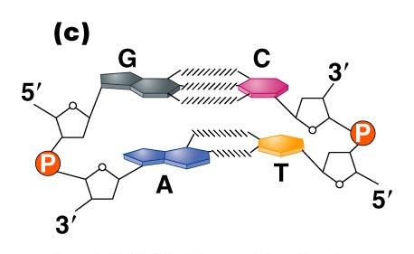
Figure 10.14c
Notes:
Figure 10_14c (a) The DNA double helix as proposed by Watson and Crick. The ribbonlike strands constitute the sugar-phosphate backbones, and the horizontal rungs constitute the nitrogenous base pairs, of which there are 10 per complete turn. The major and minor grooves are apparent. The solid vertical bar represents the central axis. (b) A detailed view depicting the bases, sugars, phosphates, and hydrogen bonds of the helix. (c) A demonstration of the antiparallel nature of the helix and the horizontal stacking of the bases.

Slide 22
(How do we know)? Determining DNA structure…
Double helix is 65 years old!! (knowledge of DNA structure)
Watson and Crick got most of the glory…but the discovery of the structure was a group effort.

Slide 23
Biochemical studies…
Erwin Chargaff—studied DNA by base composition.
Noted roughly equal concentrations of:
Purines and Pyrimidines
Specifically: [A] = [T] and [C] =[G]

Slide 24
Suggested 1:1 interactions of specific bases.
A-T and G-C
Interestingly---different species have different base compositions---Some are more A/T rich some are more G/C rich.

Slide 25
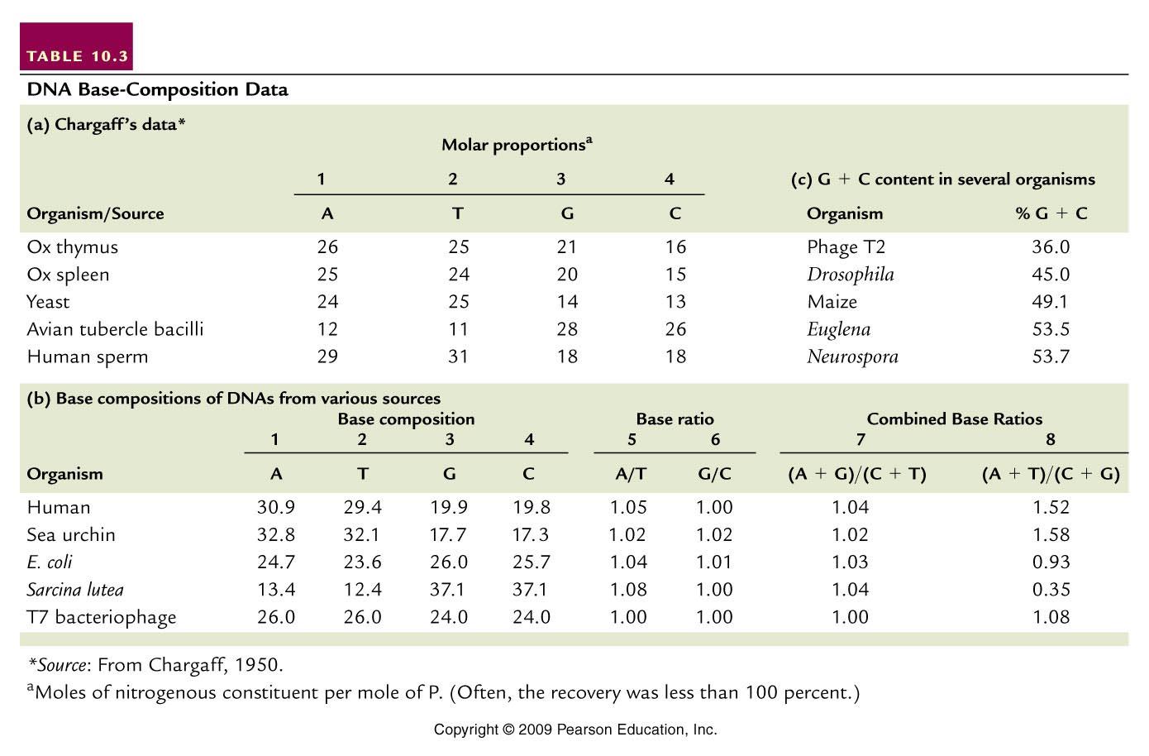
(purines=pyrimidines)
(A+T not = G +C)
Table 10.3
Notes:
Table 10.3 DNA Base Composition Data

Slide 26
Details of 3-D structure came from X-ray diffraction or X-ray crystallography experiments/pictures
X-ray diffraction gives a pattern of dots which result from X-rays bouncing off of electrons of the substance being analyzed
The more regular the pattern the more likely the structure is a symmetrical/repeated shape (the pattern for DNA resembled a helix)

Slide 27
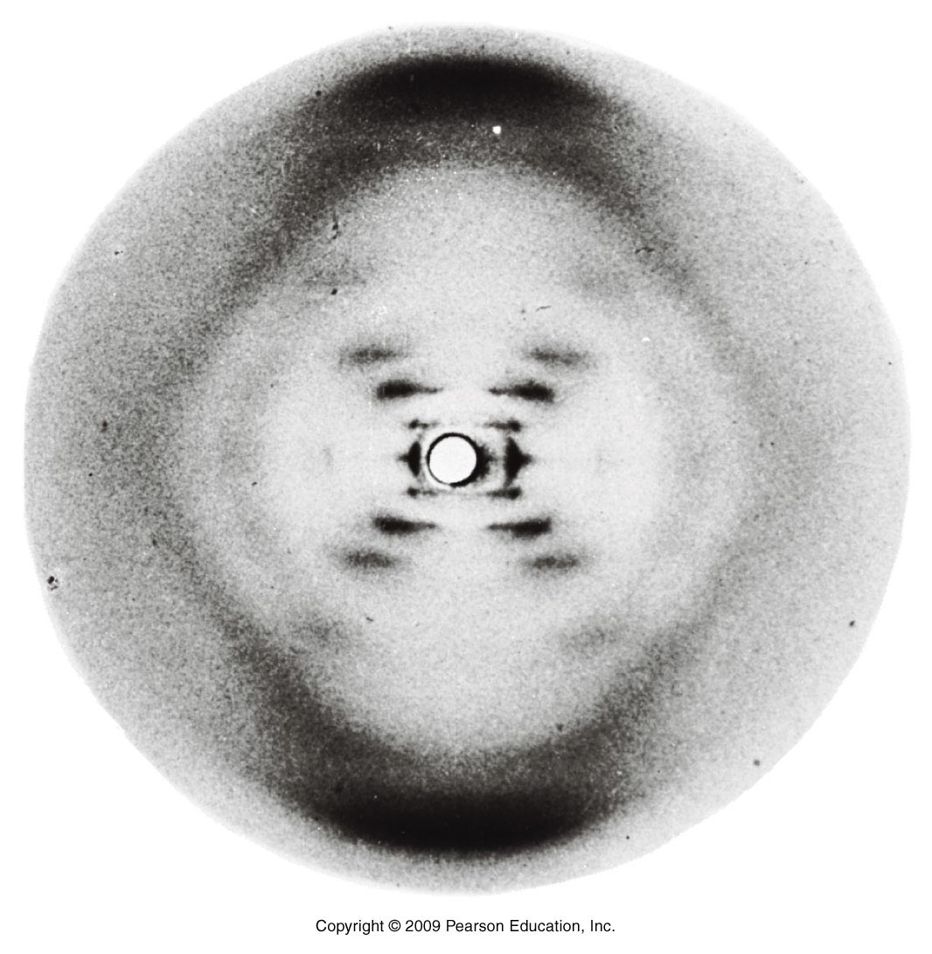
Figure 10.13
Notes:
Figure 10-13 X-ray diffraction photograph of the B form of purified DNA fibers. The strong arcs on the periphery show closely spaced aspects of the molecule, providing an estimate of the periodicity of nitrogenous bases, which are 3.4 Å apart. The inner cross pattern of spots shows the grosser aspect of the molecule, indicating its helical nature.

Slide 28
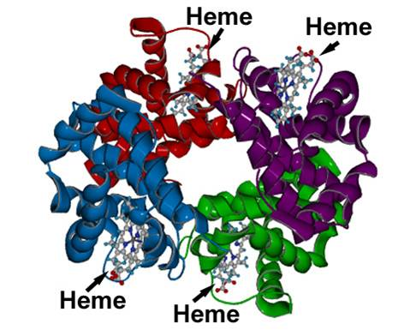
Many macromolecules have been studied with this method. The substance to be imaged must be crystalized, but can be complexed with other molecules as well.
Schematic of X-ray crystallograph of hemoglobin

Slide 29
Many scientists used X-ray diffraction to try to solve DNA structure
Linus Pauling
William Astbury
Maurice Wilkins*
Rosalind Franklin
James Watson*
Francis Crick*
*Awarded the nobel prize in 1962

Slide 30
X-ray crystallography was a new science in the 1950s. Watson and Crick were first to describe a structure that fit with both the biochemical data and the patter of scatter in the X-ray pictures.
They described a right-handed helix and very specific dimensions

Slide 31
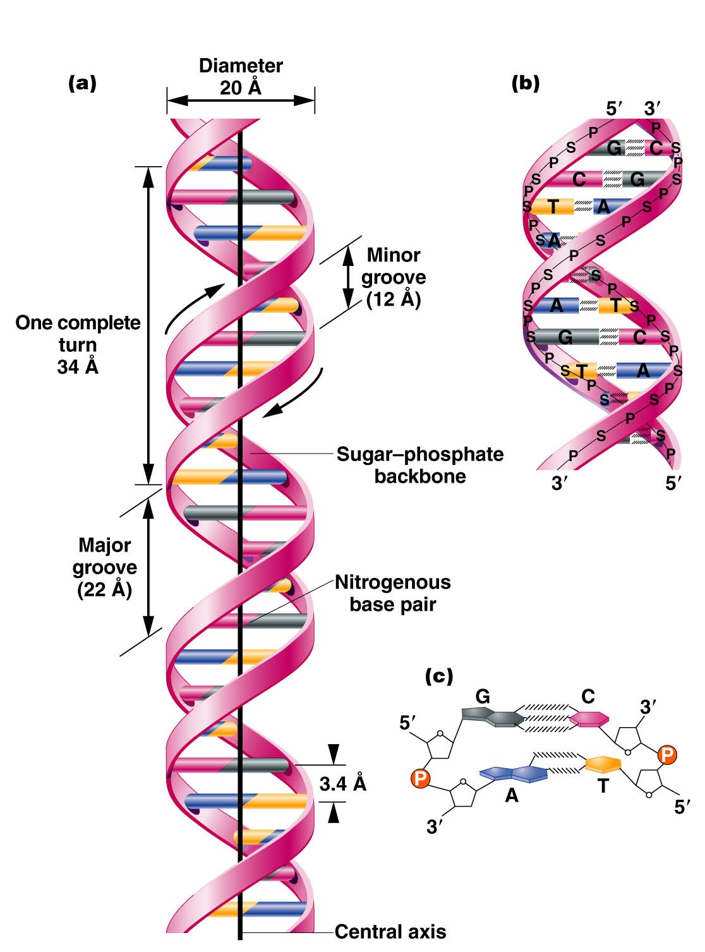
The Watson-Crick Model
B-form DNA
A=angstrom=
0.1nm
3.4 nm
.34 nm
Figure 10.14
Notes:
Figure 10-14 (a) The DNA double helix as proposed by Watson and Crick. The ribbonlike strands constitute the sugar-phosphate backbones, and the horizontal rungs constitute the nitrogenous base pairs, of which there are 10 per complete turn. The major and minor grooves are apparent. The solid vertical bar represents the central axis. (b) A detailed view depicting the bases, sugars, phosphates, and hydrogen bonds of the helix. (c) A demonstration of the antiparallel nature of the helix and the horizontal stacking of the bases.

Slide 32
Read Watson and Crick’s complete paper published in 1953 in Nature journal.
P.255-ish of your text.
Know the main dimensional details of the W-C DNA model. (list in textbook)
Please view---good science and enlightening—Decoding Watson.
https://www.pbs.org/video/decoding-watson-ua6jjx/

Slide 33
B-DNA (also called Watson-Crick form) is the most common form of DNA in cells, but not the only structure that has been described using X-ray crystallography.
Helical direction, # of bases in a turn of helix, helix diameter, shape of backbone can vary

Slide 34
DNA can change shape due to dehydration, presence of ions, and specific base sequences.
For example, Z-DNA forms readily when DNA contains G-C-G-C-G-C…. In order for base pairing to occur, the sugar-phosphate backbone makes sharp turns (zig-zag) pattern in a left turning helix.

Slide 35
A-DNA forms when DNA is not surrounded by water. It is a right handed helix, but wider, due to the increased number of bases in each turn of helix.
Both A and Z-DNA are thought to exist in cells, under certain conditions or in certain regions of a chromosome, and may even affect gene expression

Slide 36
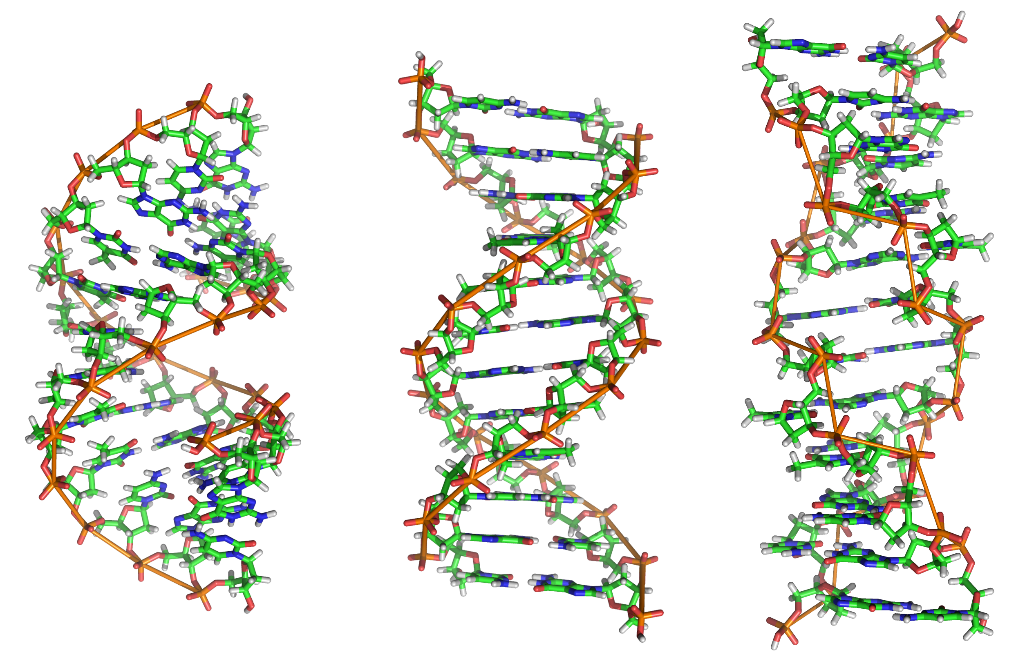
B-DNA
z-DNA
A-DNA

